Slide 1
Security and Compliance Security Best Practices, Access Control, Encryption, Audit Logging

Slide 2
Introduction
Security and compliance are essential for protecting data, systems, and users.
They ensure that organizations meet legal, ethical, and operational standards.
Focus areas: Access control, encryption, audit logging, and best practices.

Slide 3
Importance of Security and Compliance
Prevent data breaches and system misuse
Ensure privacy and confidentiality
Comply with regulations (e.g., GDPR, HIPAA)
Build customer trust
Avoid legal and financial penalties

Slide 4
Security Best Practices
Apply principle of least privilege
Use strong, unique passwords and enable MFA
Keep systems updated (patching and updates)
Segment networks to isolate sensitive resources
Back up data regularly and test recovery
Monitor systems for anomalies or intrusions

Slide 5
Access Control
What is Access Control? Restricts who can access data and what actions they can perform.
Types of Access Control:
DAC (Discretionary Access Control)
MAC (Mandatory Access Control)
RBAC (Role-Based Access Control)
ABAC (Attribute-Based Access Control)

Slide 6
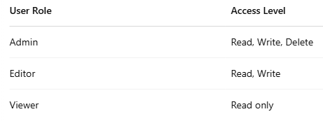
Access Control Example

Slide 7
Encryption
Definition: Converts data into a coded format that can only be read with a key.
Types of Encryption:
Symmetric: Same key for encryption/decryption (e.g., AES)
Asymmetric: Public/private key pair (e.g., RSA)
At rest: Encrypt stored data (e.g., databases, files)
In transit: Encrypt data sent over networks (e.g., HTTPS)

Slide 8
Audit Logging
What is Audit Logging? Tracks all activities in a system, recording who did what and when.
Why it matters:
Helps in detecting suspicious behavior
Useful for forensic investigation
Ensures compliance with security standards
Examples:
Logins/logouts
File access
Configuration changes

Slide 9
Compliance Standards
GDPR: Data protection for EU residents
HIPAA: Health information privacy in the U.S.
ISO/IEC 27001: International security management standard
PCI-DSS: For organizations handling credit card data

Slide 10
Key Takeaways
Protecting systems and data is a shared responsibility
Enforce access control and encryption
Log all critical actions for traceability
Stay updated on compliance requirements
Conduct regular audits and vulnerability scans

Slide 11
Summary
Security best practices reduce risk of attack
Access control ensures only authorized users take actions
Encryption protects sensitive data
Audit logs maintain accountability
Compliance ensures alignment with global standards

